Slide 1


Exact Separation Logic Bridging the gap between verification and true bug-finding
Philippa Gardner
Imperial College London
https://www.doc.ic.ac.uk/~pg/
with generous
support from
Notes:
Hello everyone, Thank you to AdaCore and Capgemini Engineering for the invitation.

Slide 2










Current Group Members
Sacha-Élie Ayoun
Nat Karmios
Andreas Lööw
Petar Maksimović
Daniele Nantes-Sobrinho
Xiaojia Rao
Some Past Group Members and a Visitor
José Fragoso Santos
(IST Lisbon)
Gabriela Sampaio
(Meta)
Julian Sutherland
(Nethermind)
Caroline Cronjäger
(Ruhr Universität Bochum)

Slide 3

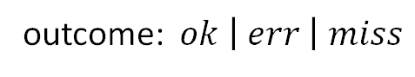

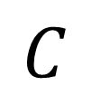

Compositional Symbolic Execution for True Bug-finding
symbolic state
$$\hat{σ}$$
$$C$$
$$Γ$$
$$o :\hat{σ}′$$
outcome: $ok \left| err \right| miss$

Slide 4







Compositional Symbolic Execution for True Bug-finding
$$\hat{σ}$$
$$∞$$
$$Mod(\hat{σ})$$
$$C$$
$$Γ$$
$$err$$
$$o :\hat{σ}′$$
$$ok$$
$$miss$$
$$Mod(\hat{σ}′)$$

Slide 5
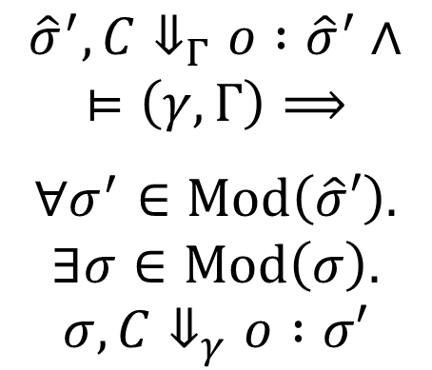
Compositional Symbolic Execution for True Bug-finding
$$\hat{σ}$$
Backward Completeness
$$∞$$
$$Mod(\hat{σ})$$
$${\hat{σ}}^{′}, C⇓_{Γ}o :{\hat{σ}}^{′}∧ \\ ⊨\left(γ, Γ\right)⟹$$ $$∀σ^{′}∈Mod\left(\hat{σ}′\right). \\ ∃σ∈Mod\left(σ\right). \\ σ, C⇓_{γ}o :σ′$$
$$C$$
$$Γ$$
$$err$$
$$o :\hat{σ}′$$
$$ok$$
$$miss$$
$$Mod(\hat{σ}′)$$

Slide 6

Compositional Symbolic Execution for True Bug-finding
$$\hat{σ}$$
Backward Completeness
$$∞$$
$$Mod(\hat{σ})$$
$${\hat{σ}}^{′}, C⇓_{Γ}o :{\hat{σ}}^{′}∧ \\ ⊨\left(γ, Γ\right)⟹$$ $$∀σ^{′}∈Mod\left(\hat{σ}′\right). \\ ∃σ∈Mod\left(σ\right). \\ σ, C⇓_{γ}o :σ′$$
$$C$$
$$Γ$$
$$err$$
Frame Preservation
for $o≠miss$
$$o :\hat{σ}′$$
$$ok$$
$$miss$$
$$Mod(\hat{σ}′)$$

Slide 7
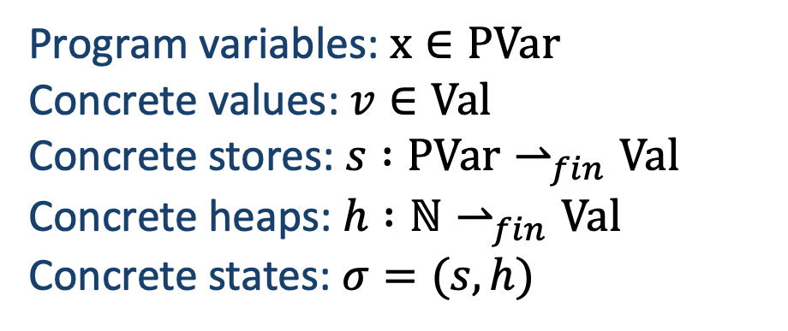
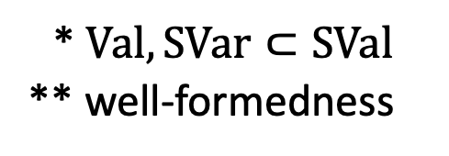
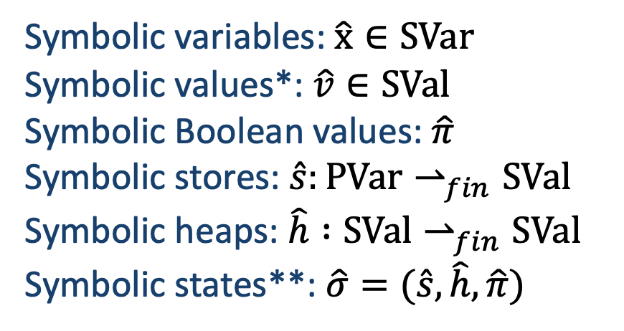
Some Syntax
Symbolic variables: $\hat{x}∈SVar$
Symbolic values*: $\hat{v}∈SVal$
Symbolic Boolean values: $\hat{π}$
Symbolic stores: $\hat{s}:PVar⇀_{fin}SVal$
Symbolic heaps: $\hat{h} :{SVal⇀}_{fin}SVal$
Symbolic states**: $\hat{σ}=(\hat{s}, \hat{h}, \hat{π})$
Program variables: $x∈PVar$
Concrete values: $v∈Val$
Concrete stores: $s :PVar⇀_{fin}Val$
Concrete heaps: $h :{ℕ⇀}_{fin}Val$
Concrete states: $σ=(s, h)$
* $Val, SVar⊂SVal$
** well-formedness

Slide 8
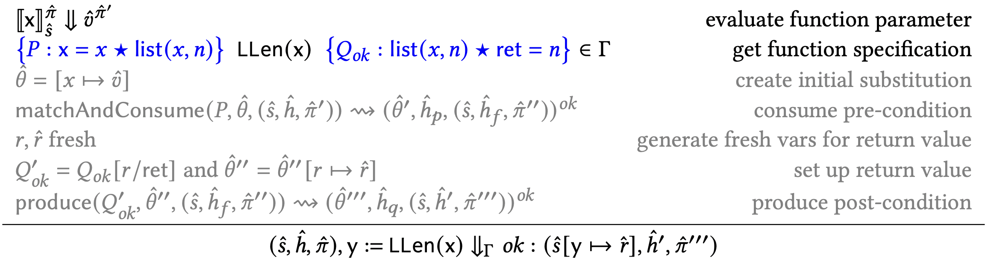
True Bug-finding with Verified Function Specifications

Slide 9
True Bug-finding with Verified Function Specifications
Problem: OX specifications break backward completeness

Slide 10

Separation Logic
OX Specification
$$Γ⊨\left\{P\right\} C \{Q\}$$
OX Interpretation
Starting from a concrete state $σ_{P}∙σ_{F}$ with $σ_{P}$ satisfying $P$, the execution of $C,$ if it terminates, does so in a state $σ_{Q}∙σ_{F}$ with $σ_{Q}$ satisfying $Q$

Slide 11
Separation Logic
OX Specification
$$Γ⊨\left\{P\right\} C \{Q\}$$
OX Interpretation
Starting from a concrete state $σ_{P}∙σ_{F}$ with $σ_{P}$ satisfying $P$, the execution of $C,$ if it terminates, does so in a state $σ_{Q}∙σ_{F}$ with $σ_{Q}$ satisfying $Q$
Problem: OX specifications not compatible with true bug-finding

Slide 12


Incorrectness Separation Logic
UX Specification
$$⊨\left[P\right] C [ok:Q]$$
$$⊨\left[P\right] C [err:Q]$$
UX Interpretation
Any concrete state $σ_{Q}∙σ_{F}$ with $σ_{Q}$ satisfying $Q$ is reachable from some state $σ_{P}∙σ_{F}$ with $σ_{P}$ satisfying $P$, by executing $C$

Slide 13

Incorrectness Separation Logic
UX Specification
$$⊨\left[P\right] C [ok:Q]$$
$$⊨\left[P\right] C [err:Q]$$
UX Interpretation
Any concrete state $σ_{Q}∙σ_{F}$ with $σ_{Q}$ satisfying $Q$, is reachable from some state $σ_{P}∙σ_{F}$ with $σ_{P}$ satisfying $P$, by executing $C$
Problem: UX specifications do not capture verification

Slide 14
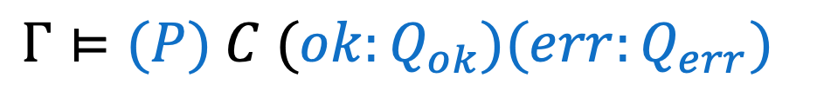
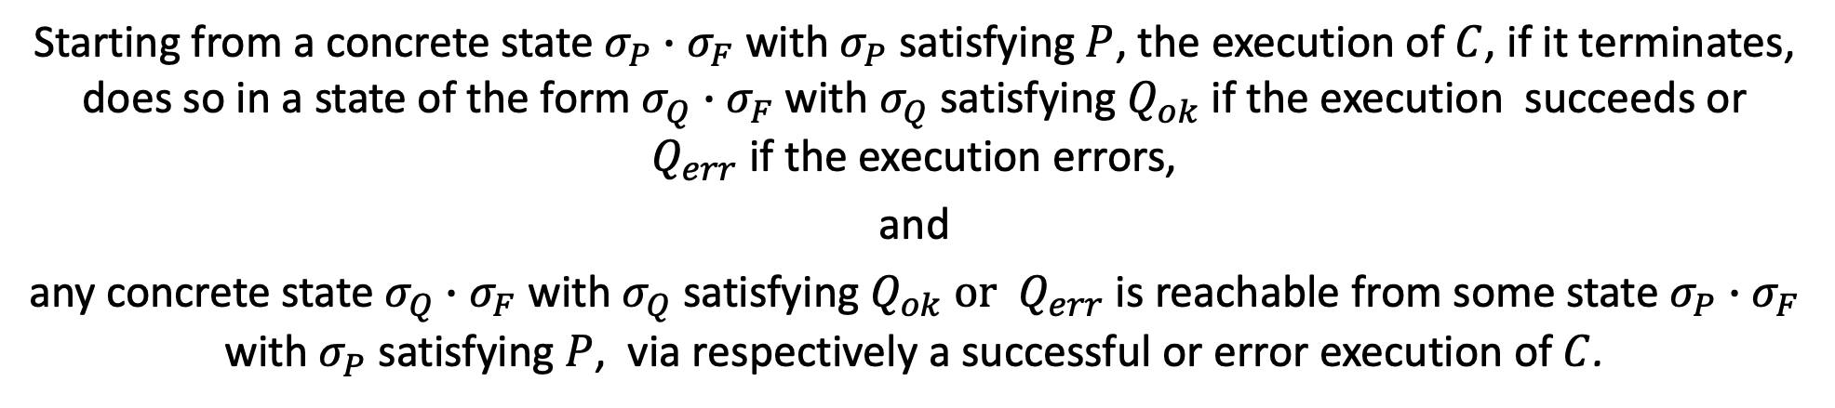
Exact Separation Logic
EX Specification
$$Γ⊨(P) C (ok:Q_{ok})(err:Q_{err})$$
EX Interpretation
Starting from a concrete state $σ_{P}∙σ_{F}$ with $σ_{P}$ satisfying $P$, the execution of $C$, if it terminates, does so in a state of the form $σ_{Q}∙σ_{F}$ with $σ_{Q}$satisfying $Q_{ok}$ if the execution succeeds or $Q_{err}$if the execution errors,
and
any concrete state $σ_{Q}∙σ_{F}$ with $σ_{Q}$ satisfying $Q_{ok} or { Q}_{err}$is reachable from some state $σ_{P}∙σ_{F}$ with $σ_{P}$ satisfying $P$, via respectively a successful or error execution of $C$.

Slide 15
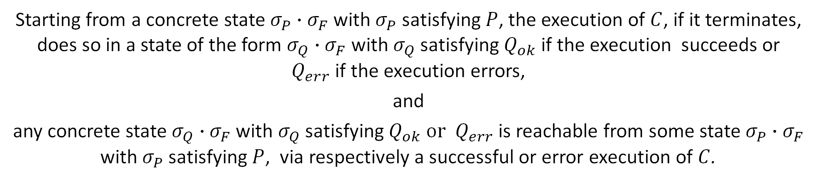
Exact Separation Logic
EX Specification
$$Γ⊨(P) C (ok:Q_{ok})(err:Q_{err})$$
EX Interpretation
Starting from a concrete state $σ_{P}∙σ_{F}$ with $σ_{P}$ satisfying $P$, the execution of $C$, if it terminates, does so in a state of the form $σ_{Q}∙σ_{F}$ with $σ_{Q}$satisfying $Q_{ok}$ if the execution succeeds or $Q_{err}$if the execution errors,
and
any concrete state $σ_{Q}∙σ_{F}$ with $σ_{Q}$ satisfying $Q_{ok} or { Q}_{err}$is reachable from some state $σ_{P}∙σ_{F}$ with $σ_{P}$ satisfying $P$, via respectively a successful or error execution of $C$.
Solution: EX specifications are compatible with true bug-finding

Slide 16
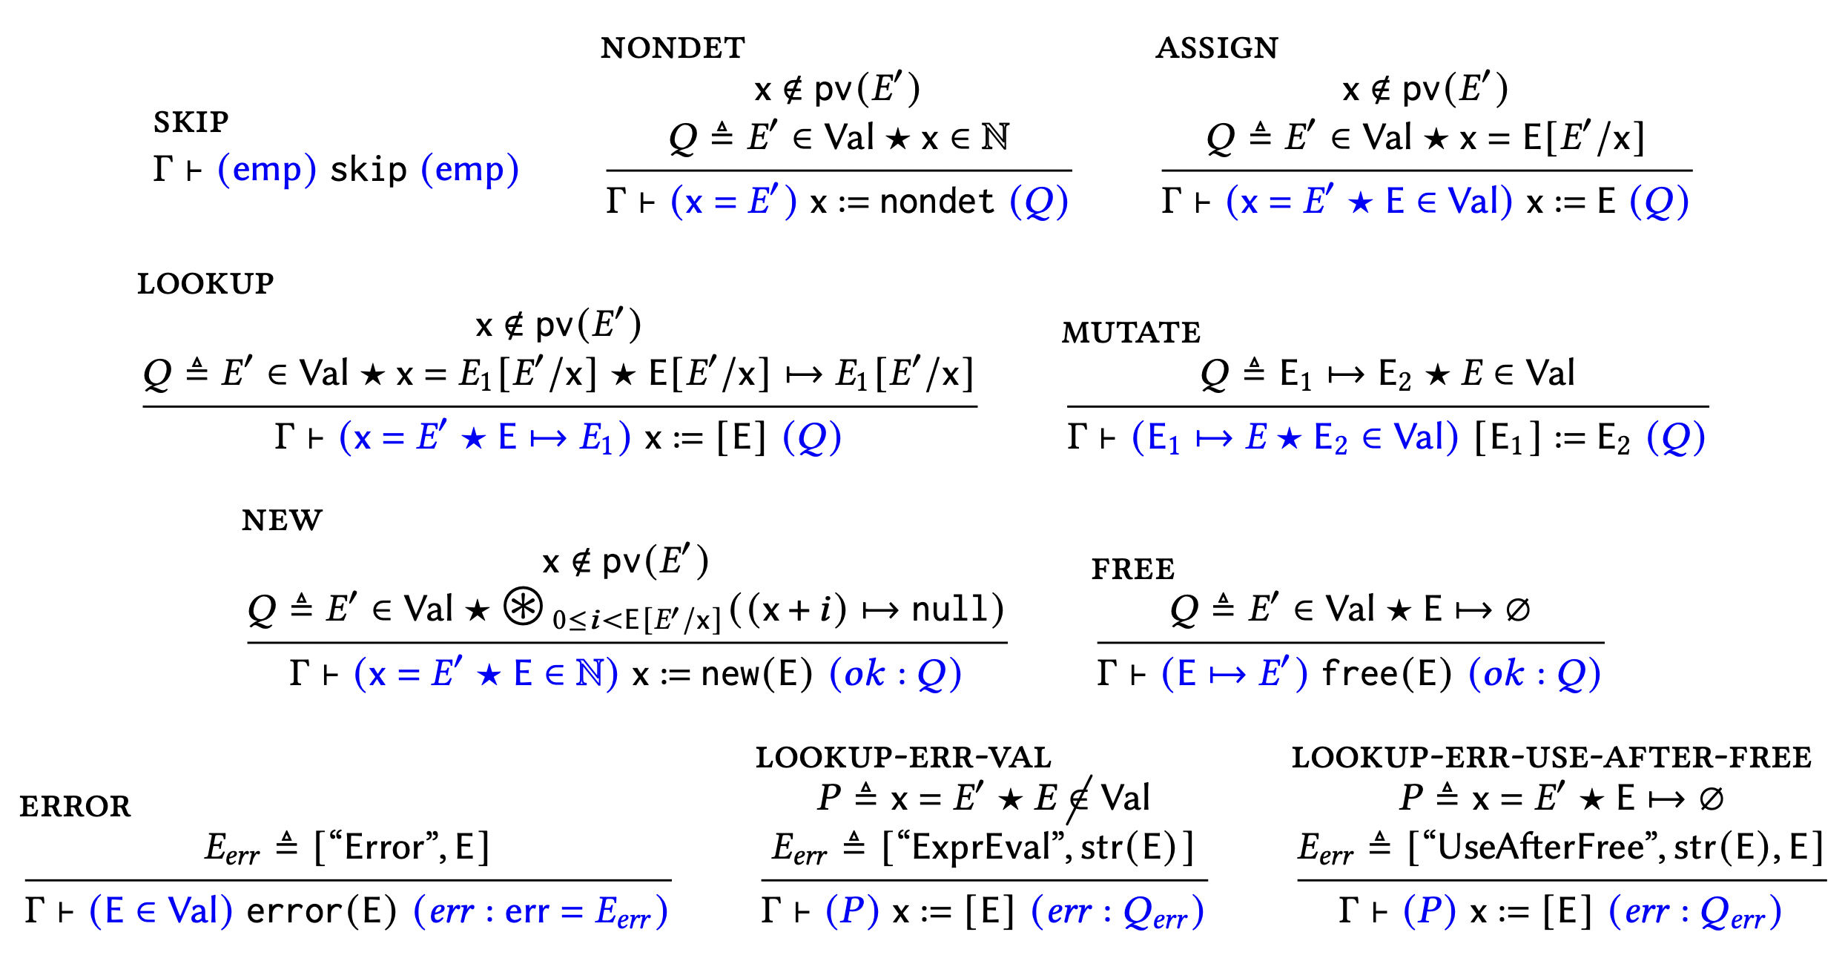
Exact Separation Logic: Basic Commands

Slide 17
Exact Separation Logic: Basic Commands
Information in precondition must be preserved in postcondition
* pure assertions (e.g., $x=E′$ and $E∈Val$) are only satisfied in the empty heap

Slide 18
Exact Separation Logic: Basic Commands
Negative information about deallocated resource

Slide 19
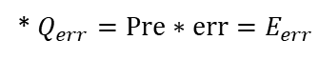
Exact Separation Logic: Basic Commands
Explicit treatment of errors
* $Q_{err}=Pre∗err=E_{err}$

Slide 20
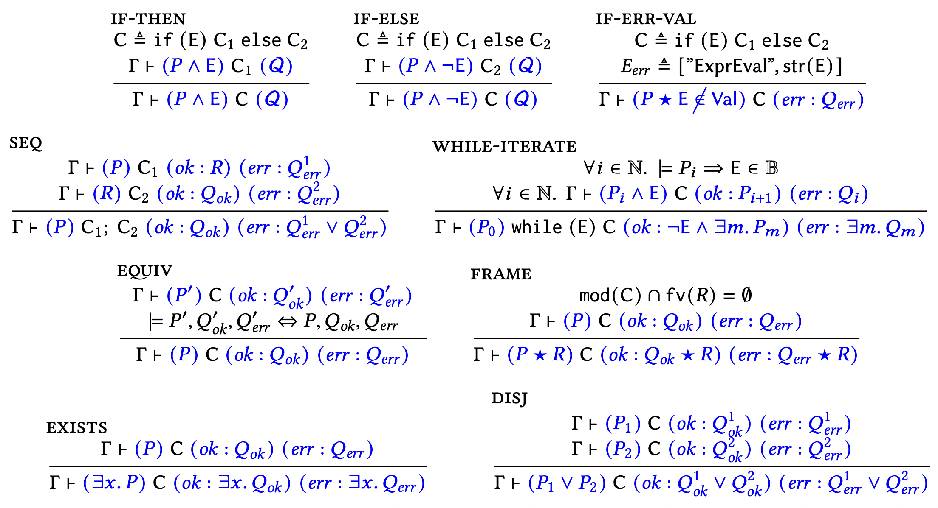
Exact Separation Logic: Compound and Structural Commands

Slide 21
Exact Separation Logic: Compound/Structural Commands
Sequential composition of successful and error outcomes

Slide 22
Exact Separation Logic: Compound/Structural Commands
While rule as in Reverse Hoare Logic

Slide 23
Exact Separation Logic: Compound/Structural Commands
Equivalence instead of forward/backward consequence

Slide 24
Exact Separation Logic: Compound/Structural Commands
Existential elimination does something

Slide 25
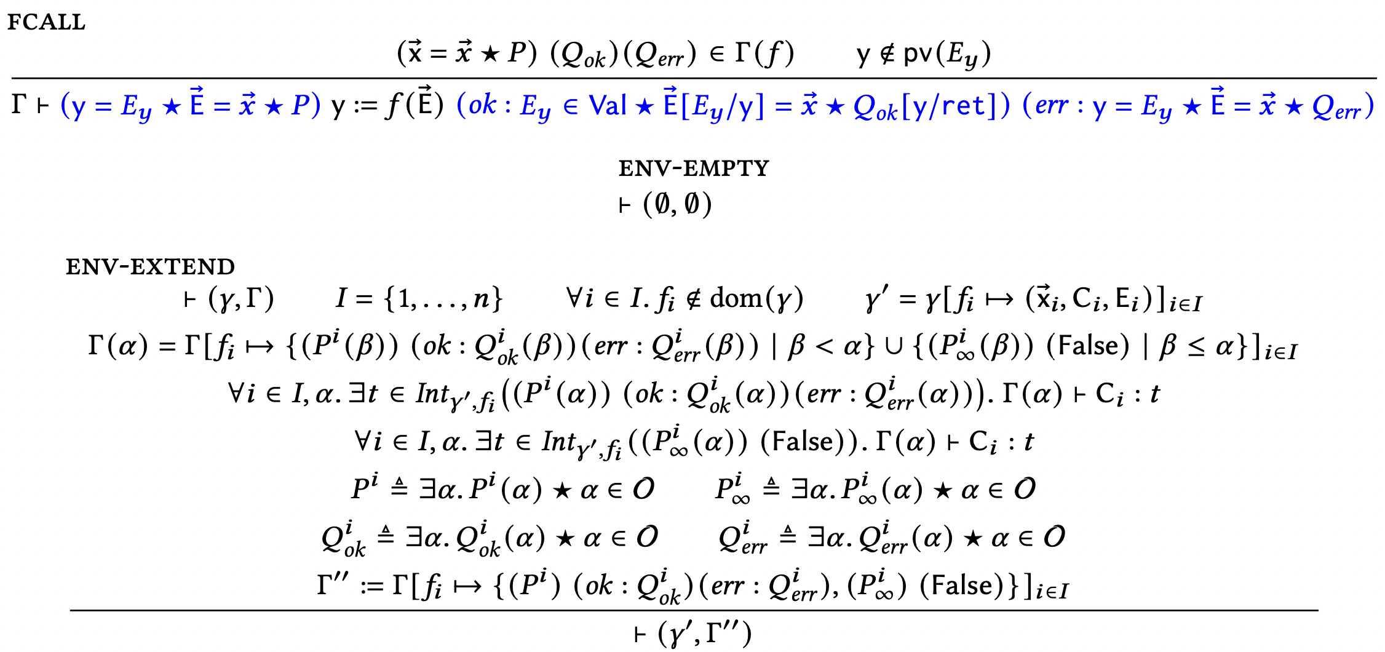
Exact Separation Logic: Functions

Slide 26
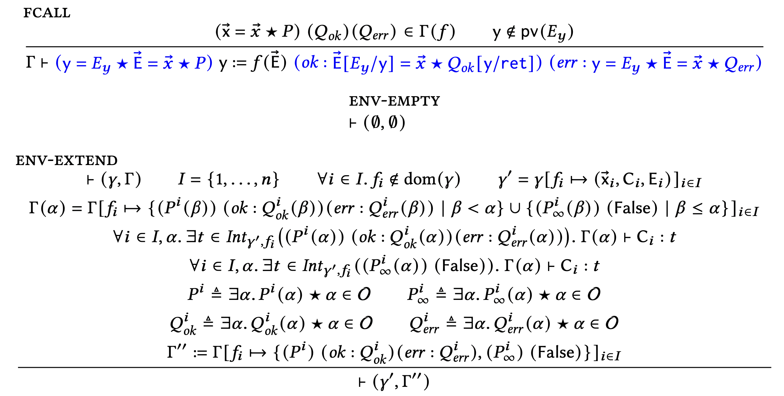
Exact Separation Logic: Env-Extend
Starting from a well-formed environment, $\left(γ, Γ\right)$,

Slide 27

Exact Separation Logic: Env-Extend
Starting from a well-formed environment, $\left(γ, Γ\right)$, we add a fresh cluster of mutually recursive functions, ${\{f}_{i} \left| i∈I\right\}$,

Slide 28

Exact Separation Logic: Env-Extend
Starting from a well-formed environment, $\left(γ, Γ\right)$, we add a fresh cluster of mutually recursive functions, ${\{f}_{i} \left| i∈I\right\}$, which have some terminating specs

Slide 29
Exact Separation Logic: Env-Extend
Starting from a well-formed environment, $\left(γ, Γ\right)$, we add a fresh cluster of mutually recursive functions, ${\{f}_{i} \left| i∈I\right\}$, which have some terminating specs and some non-terminating specs.

Slide 30
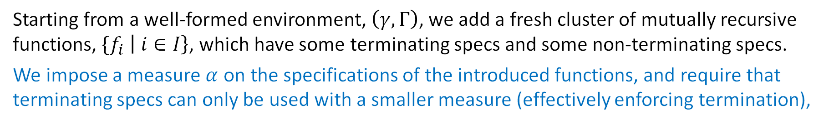
Exact Separation Logic: Env-Extend
Starting from a well-formed environment, $\left(γ, Γ\right)$, we add a fresh cluster of mutually recursive functions, ${\{f}_{i} \left| i∈I\right\}$, which have some terminating specs and some non-terminating specs.
We impose a measure $α$ on the specifications of the introduced functions, and require that terminating specs can only be used with a smaller measure (effectively enforcing termination),

Slide 31
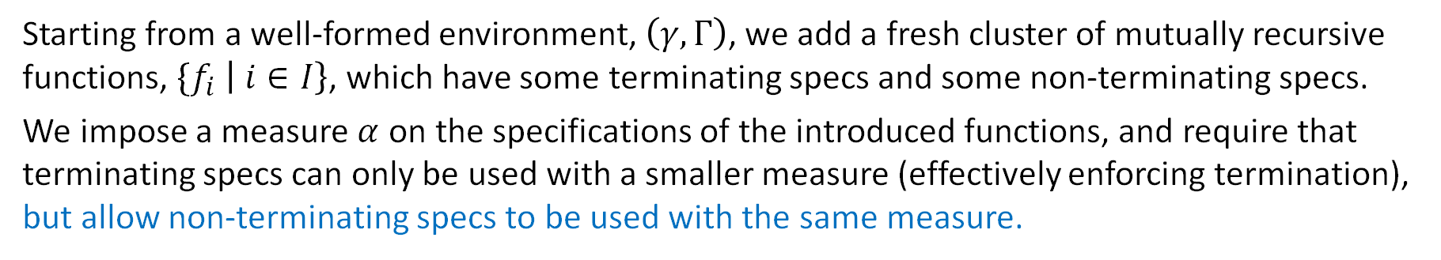
Exact Separation Logic: Env-Extend
Starting from a well-formed environment, $\left(γ, Γ\right)$, we add a fresh cluster of mutually recursive functions, ${\{f}_{i} \left| i∈I\right\}$, which have some terminating specs and some non-terminating specs.
We impose a measure $α$ on the specifications of the introduced functions, and require that terminating specs can only be used with a smaller measure (effectively enforcing termination), but allow non-terminating specs to be used with the same measure.

Slide 32
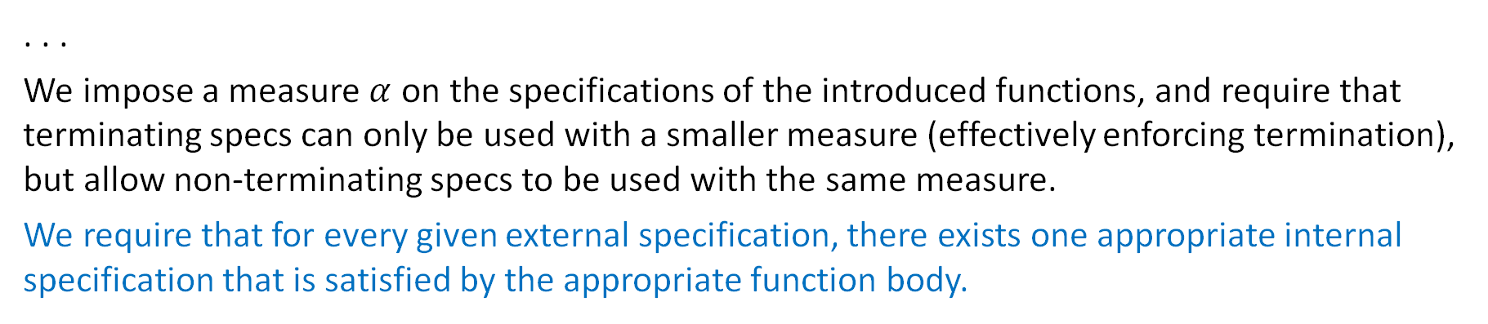
Exact Separation Logic: Env-Extend
. . .
We impose a measure $α$ on the specifications of the introduced functions, and require that terminating specs can only be used with a smaller measure (effectively enforcing termination), but allow non-terminating specs to be used with the same measure.
We require that for every given external specification, there exists one appropriate internal specification that is satisfied by the appropriate function body.

Slide 33
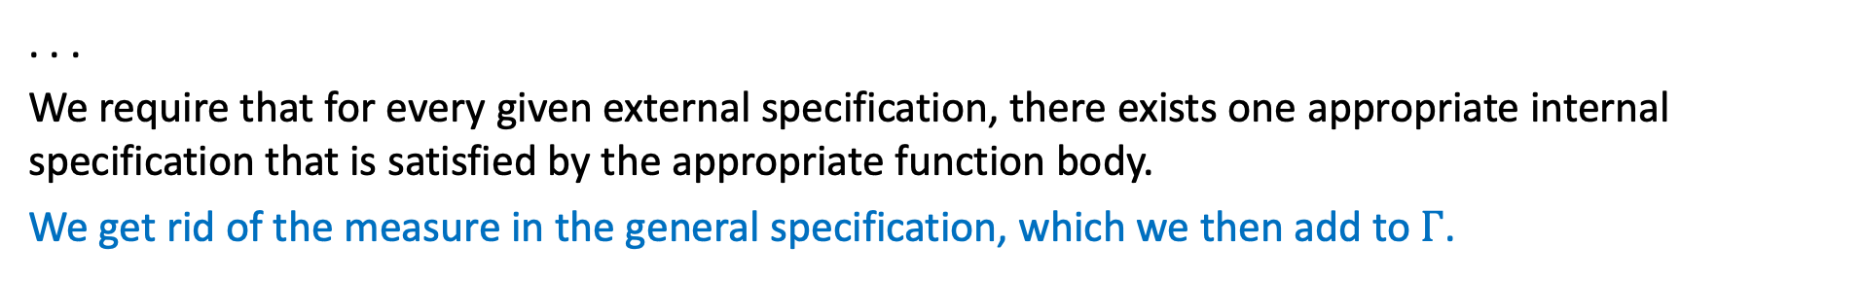
Exact Separation Logic: Env-Extend
. . .
We require that for every given external specification, there exists one appropriate internal specification that is satisfied by the appropriate function body.
We get rid of the measure in the general specification, which we then add to $Γ$.

Slide 34

Exact Separation Logic: Correctness
Any derivable specification is valid
$$Γ⊢(P) C \left(ok:Q_{ok}\right)\left(err:Q_{err}\right)⟹Γ⊨(P) C (ok:Q_{ok})(err:Q_{err})$$
Proof: by induction on LHS derivation
Any well-formed environment is valid
$$⊢\left(γ, Γ\right)⟹ ⊨\left(γ, Γ\right)$$
Proof: by transfinite induction and Scott induction

Slide 35
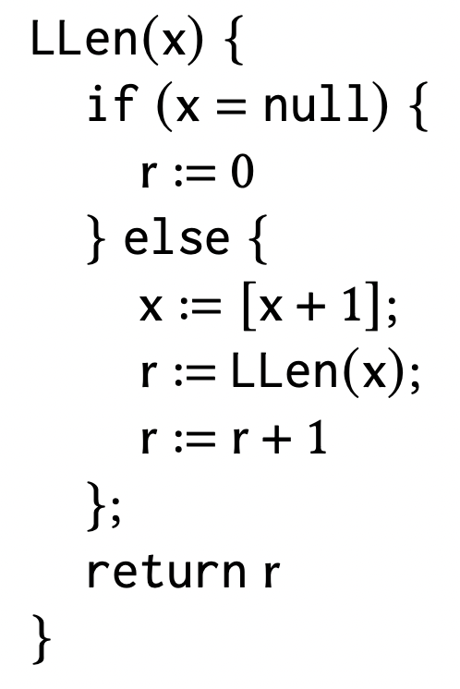
ESL Example: List-length Algorithm
List–length code

Slide 36
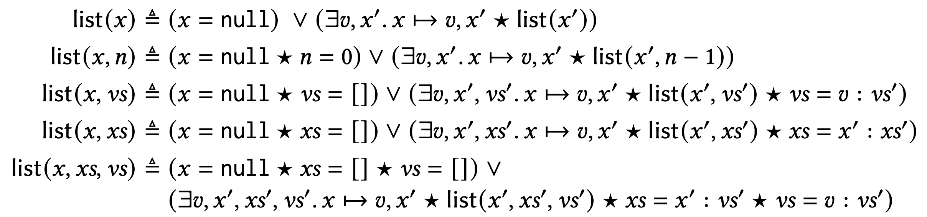
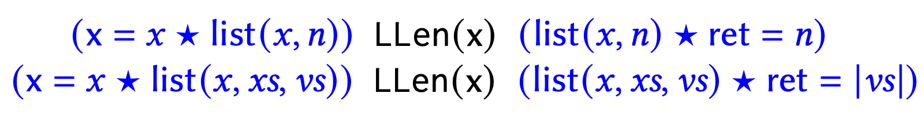
ESL Example: List-length Algorithm
List abstractions
List–length code
Two list-length specifications

Slide 37
ESL Example: List-length Proof Sketch
Abstraction:
Specification:

Slide 38
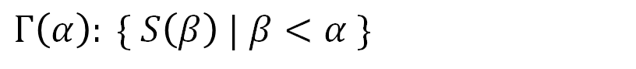
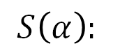
ESL Example: List-length Proof Sketch
Abstraction:
Specification:
Step 1: Set up environment
Measure: $α=n$
$$S\left(α\right):$$
$$Γ\left(α\right): \{ S\left(β\right) | β<α \}$$

Slide 39
ESL Example: List-length Proof Sketch
Abstraction:
Specification:
Step 1: Set up environment
Measure: $α=n$
$$S\left(α\right):$$
$$Γ\left(α\right): \{ S\left(β\right) | β<α \}$$
Step 2: Prove function body, obtaining internal post-condition
Step 3: Move from internal to external post-condition

Slide 40
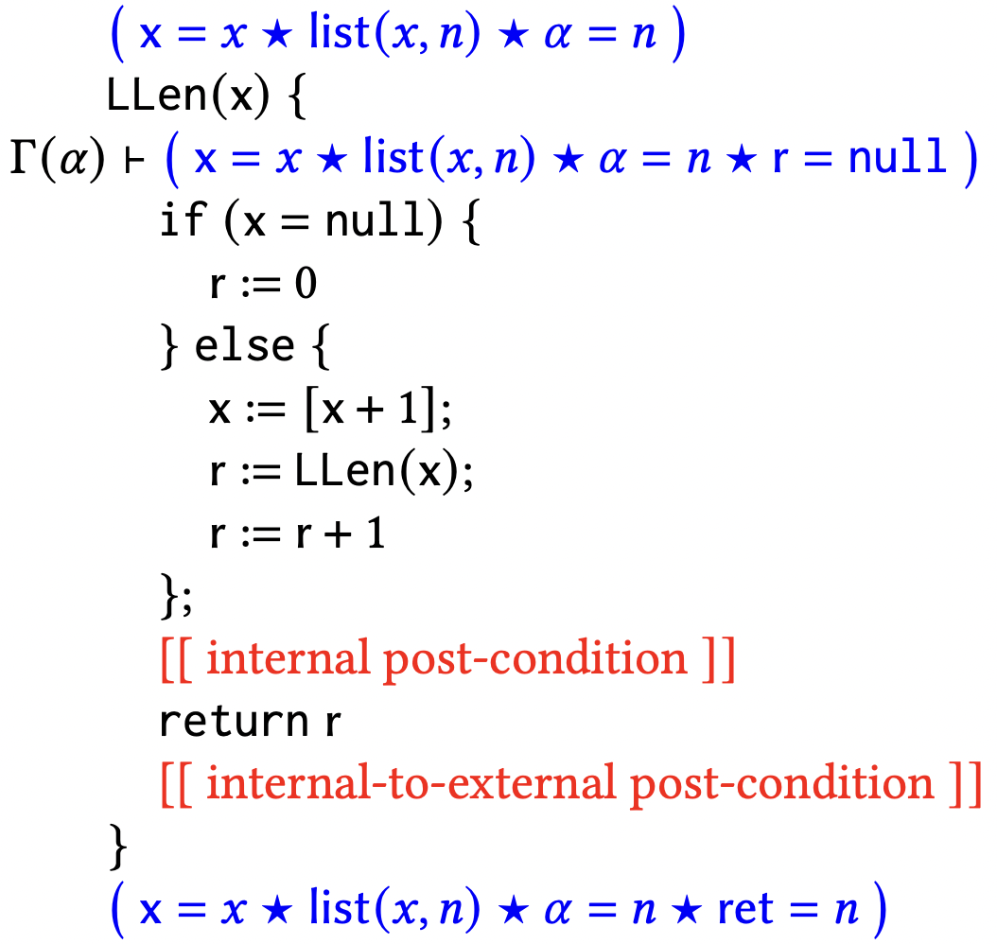
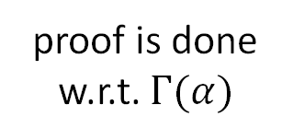
ESL Example: List-length Proof Sketch
Step 2: Prove function body, obtaining internal post-condition
external-to-internal pre-condition: initialise local variables
proof is done w.r.t. $Γ(α)$

Slide 41
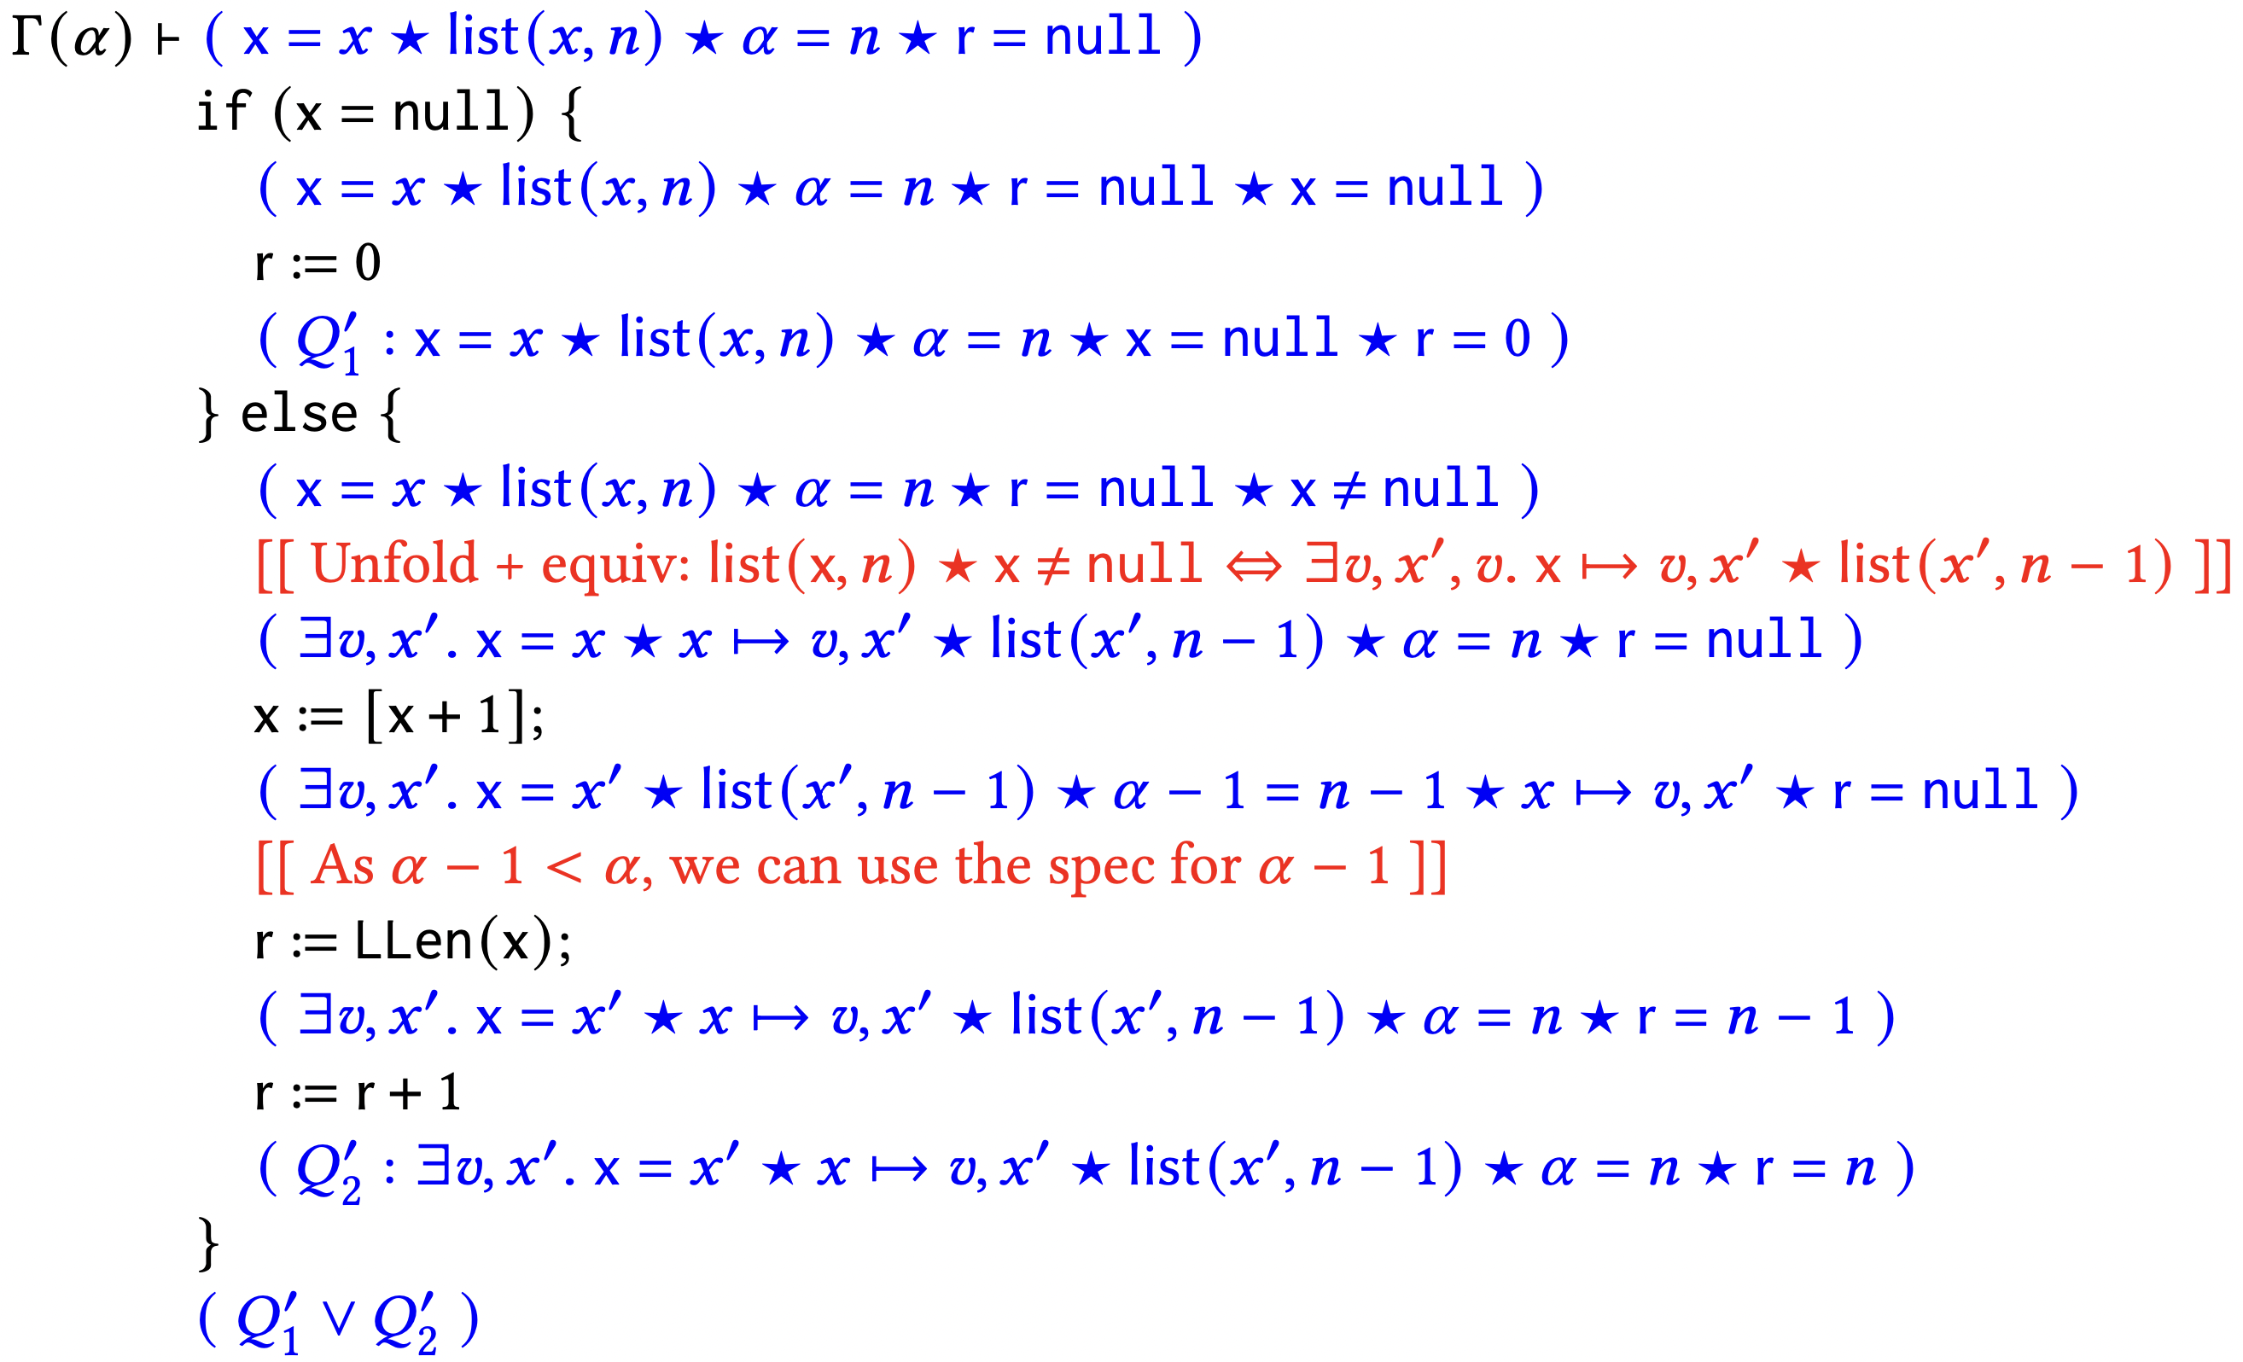
ESL Example: List-length Proof Sketch
Step 2: Prove function body, obtaining internal post-condition

Slide 42
ESL Example: List-length Proof Sketch
Step 2: Prove function body, obtaining internal post-condition
Cannot fold back the list predicate, because program variable x holds internal pointer, and cannot be forgotten because UX

Slide 43
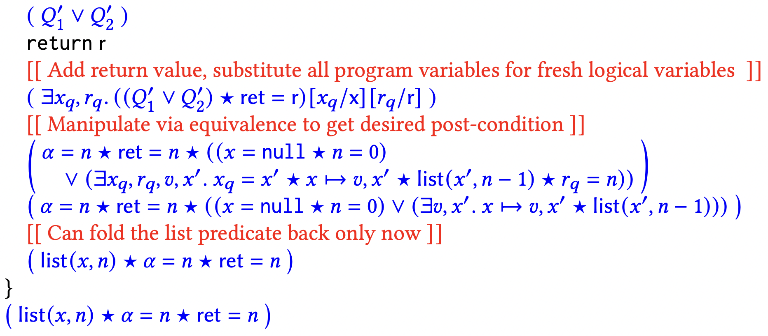
ESL Example: List-length Proof Sketch
Step 3: Move from internal to external post-condition
External specs must not have program variables

Slide 44
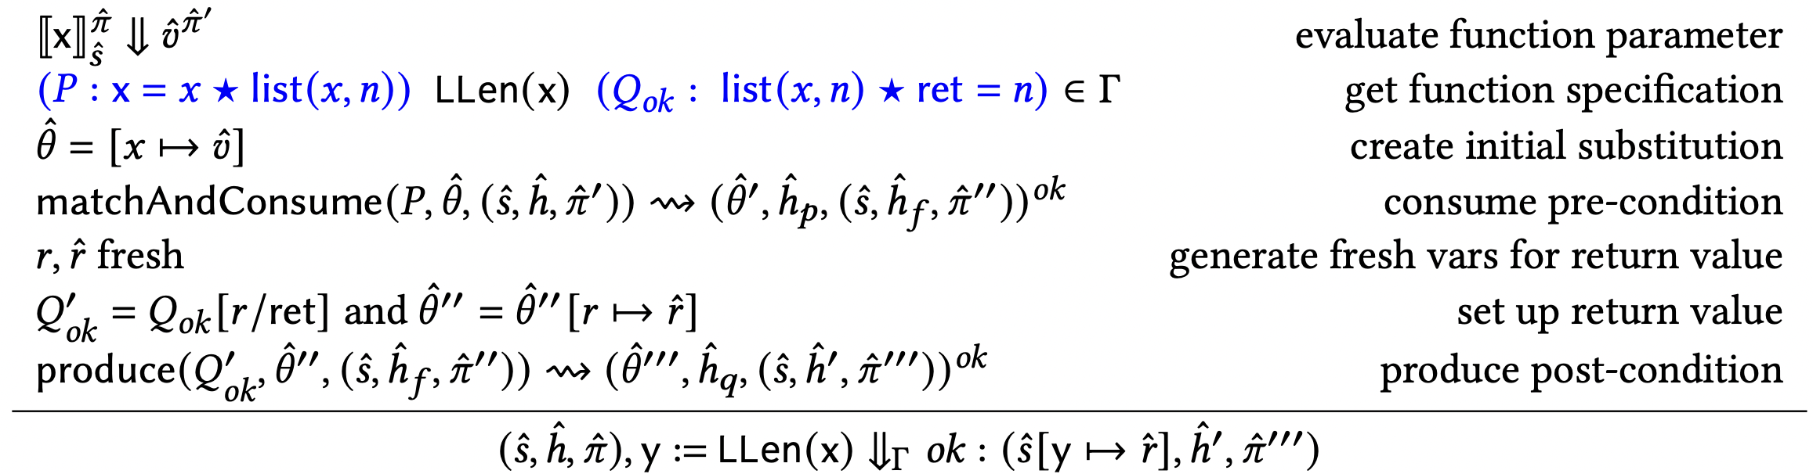
True Bug-finding with Verified Function Specifications

Slide 45
True Bug-finding with Verified Function Specifications
Problem: the list abstraction is too abstract

Slide 46
True Bug-finding with Verified Function Specifications
One solution: use a strictly-exact list predicate. Support for predicates in CSE in progress.

Slide 47
True Bug-finding with Verified Function Specifications
Correctness: Backward Completeness

Slide 48
True Bug-finding with Verified Function Specifications
Correctness: Backward Completeness
matchAndConsume and produce relations currently described axiomatically; formalisation in progress.

Slide 49
Contributions
Introduction of exact specifications and an exact separation logic for verifying such specifications
The first proof of sound function compositionality for a non-OX program logic
Demonstration that inductively-defined predicates are compatible with UX program logics
Adaptation of the Gillian program analysis platform to support exact verification
A compositional symbolic execution semantics for true bug-finding which calls verified function specifications

